Slide 1
Curriculum, Progress and Achievement #LearnerProgress

Slide 2
Why this work?
We need all leaders and teachers to understand the curriculum frameworks and translate this into their local curriculum design.
We need all kura and school to have a local curriculum that is right for them.
We need all children to access rich learning that is informed by quality assessment, and quality evidence informing rich learning.

Slide 3
Programme aim
The Curriculum, Progress and Achievement programme aims to build on current use of The New Zealand Curriculum and Te Marautanga o Aotearoa to focus on progress and achievement across the curricula, including key capabilities for success in life, learning and work
and
Deliver advice for the collection and use of assessment and aromatawai information to inform all levels of the system

Slide 4
Why focus on progress and achievement across the curricula?
Focusing on progress and achievement across the curricula will help teachers and kaiako to provide the right learning opportunities and support for each learner.
Parents and whānau will know what progress their children are making across the curricula, including key capabilities for success in life, learning and work, and how they can best support their children’s learning.
Schools, kura and Communities of Learning | Kāhui Ako will have meaningful information about progress and achievement across the curricula to help them make important decisions about ways to better support their students’ learning.

Slide 5
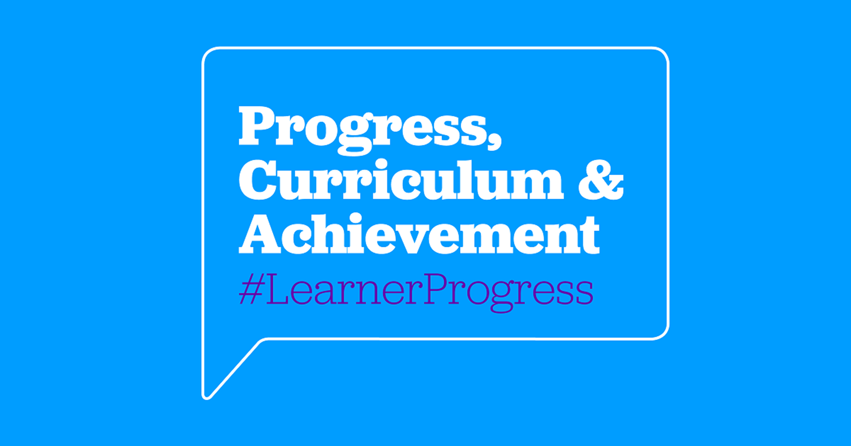
Who are we working with to consider these shifts?
Ministerial Advisory Group with expertise across The New Zealand Curriculum and Te Marautanga o Aotearoa.
A Reference Group with wide representation.
Education Conversation | Kōrero Mātauranga.

Slide 6
Shifts in curriculum
From | To
Narrow focus on Maths and Literacy | Rich, broad curriculum Local curriculum that considers the context of the local community Weaving of the “front end” of the New Zealand Curriculum (Key competencies) Endorsing the importance of the Graduate Profile is Te Marautanga
Local Curriculum Design tool
Foundational Learning
Digital Technologies
Hangarau Matahiko
Kāhui Ako

Slide 7
Shifts in assessment and aromatawai
From | To
Narrow focus on Maths and Literacy Compliance focused Focus on Achievement | Focus on progress Refocus on the Assessment position papers Encourage use of PACT and TWA Encourage use of Learning Progression Frameworks, including a focusing on expectations for students who may learn in a curriculum level for extended period Increasing need for evaluative capability
LPF
&
PACT
Anga Tupuranga
&
TWA
Digital Technologies
Hangarau Matahiko
PLD

Slide 8
Shifts in understanding system performance
From | To
One data source for all levels of the system allocation of support Strategic planning PLD targets | Opportunity to consider best fit data for all parties in the system. What should we measure? When should we measure? For what purposes should we measure? What information do students, teachers, RTLBs, school boards and the Ministry need? What information should inform allocation of supports?
Activity

Slide 9
What will it mean for schools and kura?
Assessment, aromatawai and reporting systems will continue to evolve in order to support a focus on progress and achievement across the breadth of the curricula.
We will build on what is already working well.
The Ministry will work with the sector, with input from parents, whānau, iwi and communities to ensure that teachers and kaiako, schools and kura have the capability and tools they need.

Slide 10
Guidance and support for schools and kura
Updated guidance – published 1 June 2018:
Guidance for schools using The New Zealand Curriculum is based on stories from eight schools that illustrate a range of approaches and methods.
For kura and Māori medium settings working with Te Marautanga o Aotearoa, we are continuing to provide guidance on how to use Te Waharoa Ararau to support the collation of student progress and achievement information for reporting.
Link: http://assessment.tki.org.nz/Assessment-and-reporting-guide/School-stories-a-variety-of-approaches-to-assessment
Progress tools:
Enhancements to the Progress and Consistency Tool, and Te Waharoa Ararau went live on 28 May to align with the curriculum levels 1 to 5 for Years 1 to 10.
We are currently re-positioning the LPF and PaCT to clearly articulate their purpose and benefits.
We will continue to enhance the tools to provide richer views of progress that can be easily understood.

Slide 11
Why Curriculum Progress Tools?
The Learning Progression Frameworks (LPF)
The Progress and Consistency Tool (PaCT)
Te Waharoa Ararau
He Ara Ako i te Reo Matatini

Slide 12
Te Marautanga o Aotearoa Progress Tools
Te Waharoa Ararau
He Ara Ako i te Reo Matatini

Slide 13
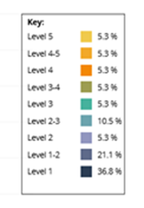
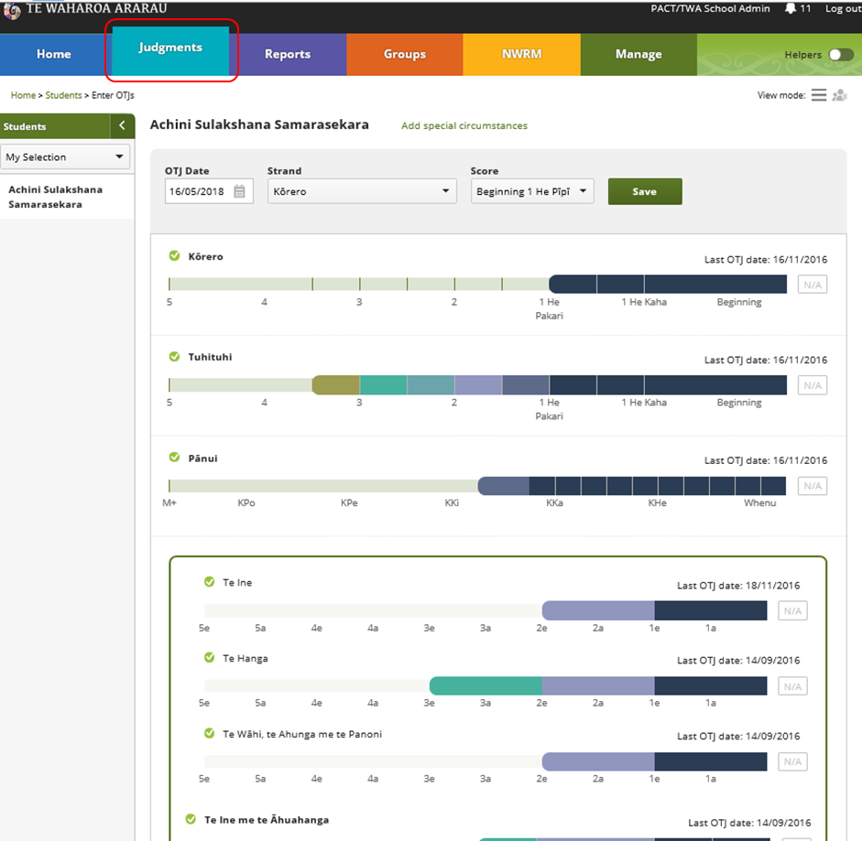
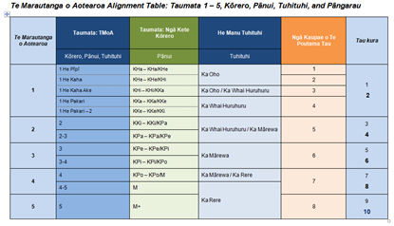
Te Waharoa Ararau
OTJs can be entered up to TMoA level 5
Each curriculum level
identifiable by colour code
Measures are unchanged
– TMoA levels and sub-levels
Latest OTJs report can be viewed in TMoA and
NWRM format, but only printable in NWRM format

Slide 14
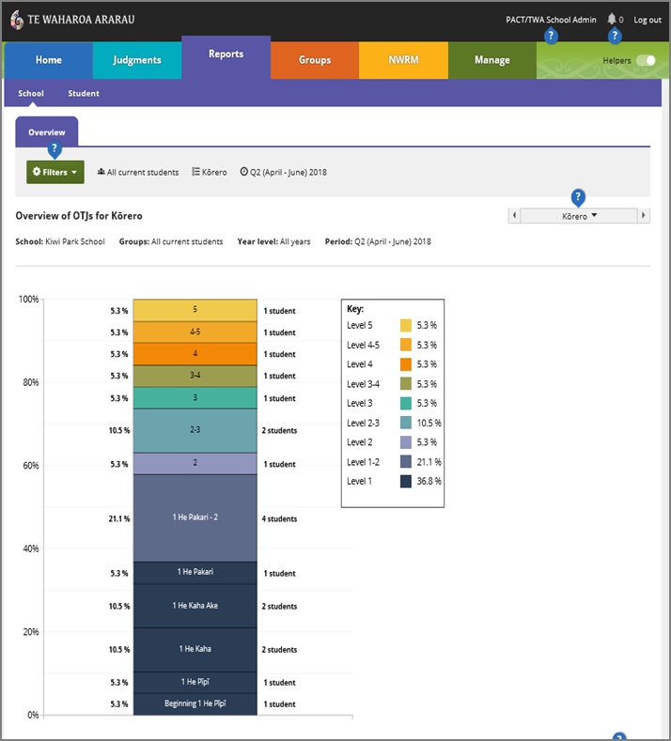
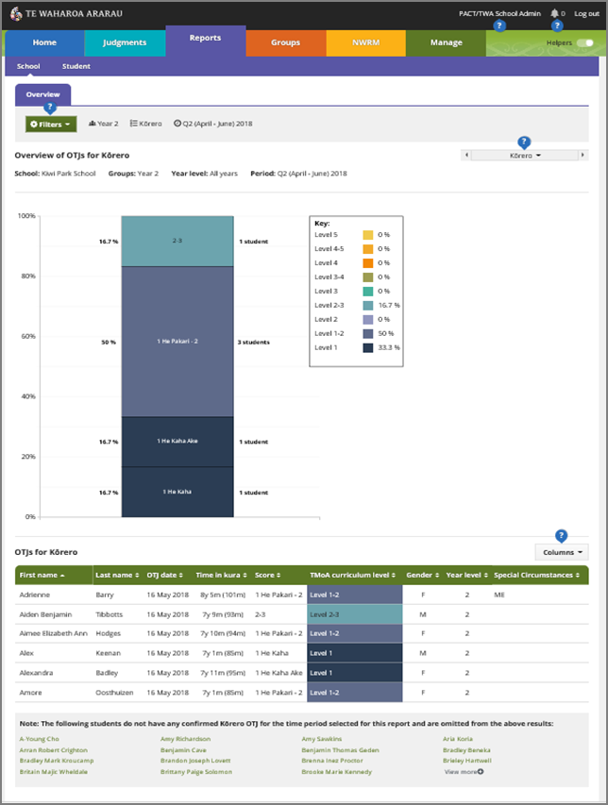
Information for Kura and classroom level reporting

Slide 15
He Ara Ako i te Reo Matatini (Literacy Learning Progressions)
Literacy learning progressions for pānui and tuhituhi to support kaiako planning and delivery of effective pānui and tuhituhi programmes
Identifies and describes key reo matatini skills, strategies and knowledge ākonga require to meet the pānui and tuhituhi demands of Te Marautanga o Aotearoa, while the Marau ā-Kura provides the context for learning
Presented as learning indicators that are developmental in nature, supporting ākonga to build on prior learning

Slide 16
2018 - 2020
Anga Tupuranga
Development of Anga Tupuranga as a stand alone online tool
Pāngarau; and
Te Reo Matatini
Kōrero – Oral language
Pānui - Reading
Tuhituhi – Writing
And integrate calibrated Anga Tupuranga into TWA
Anga Tupuranga Pāngarau (Draft)
TWA reporting
Work to incorporate learnings about progress and achievement in kura to refresh reports for ākonga, whānau, kāhui ako, targeted initiatives, governance and planning.

Slide 17
Curriculum Progress Tools
The Learning Progression Frameworks (LPF)
The Progress and Consistency Tool (PaCT)

Slide 18
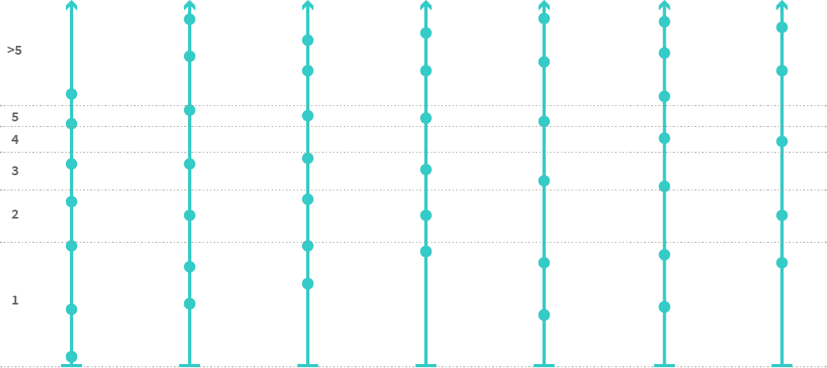
The Learning Progressions Frameworks

Slide 19
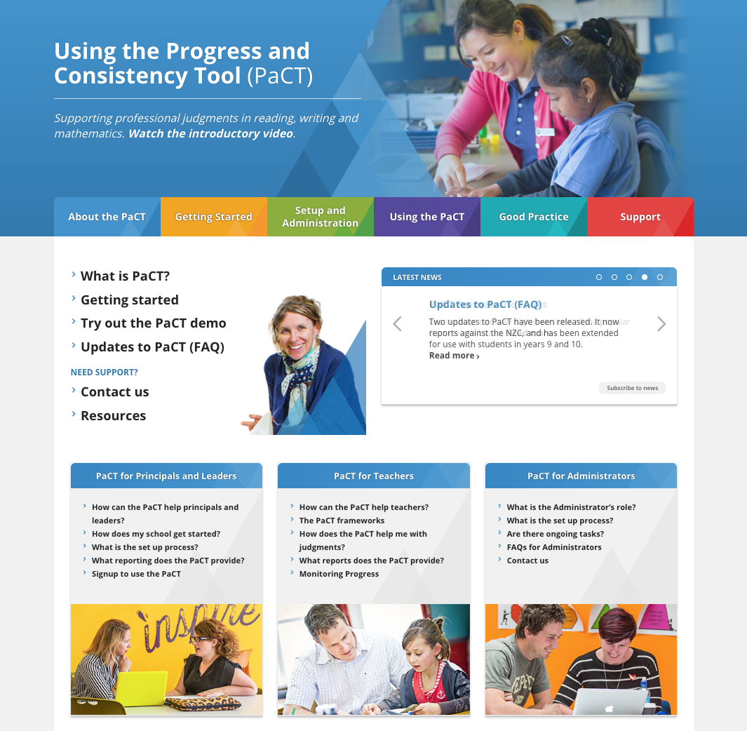
Curriculum
progress tools
Using the Curriculum Progress Tools
The Learning Progression Frameworks (LPF)
The Progress and Consistency Tool (PaCT)

Slide 20
What does this mean for RTLBs?
Schools will be expected to have a focus on assessing and reporting on progress.
Assessment and aromatawai tools and supports are evolving.
RTLB outcomes frameworks should align with what schools are doing.

Slide 21
Next Steps
Engagement 1 October to end November
MAG’s recommendations to Minister Dec 2018
Guidance on assessment and reporting for 2019

Slide 22
#LearnerProgress http://www.conversation.education.govt.nz/conversations/curriculum-progress-and-achievement/

